Slide 1
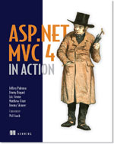




Building External DSLs Jimmy Bogard - @jbogard jimmybogard.lostechies.com Headspring

Slide 2
What is a DSL?
A computer programming language
of limited expressiveness
focused on a particular domain

Slide 3
Types of DSLs

Slide 4
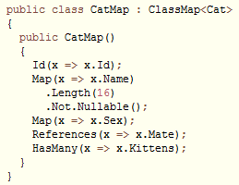
Internal DSLs
Notes:
Written in a general-purpose language
Uses subset of language’s features
Built to handle one small aspect of the overall system
Written Ruby, C#, Boo etc.
When to use Internal DSLs?
Good for when coders are using the DSL
More static in nature

Slide 5
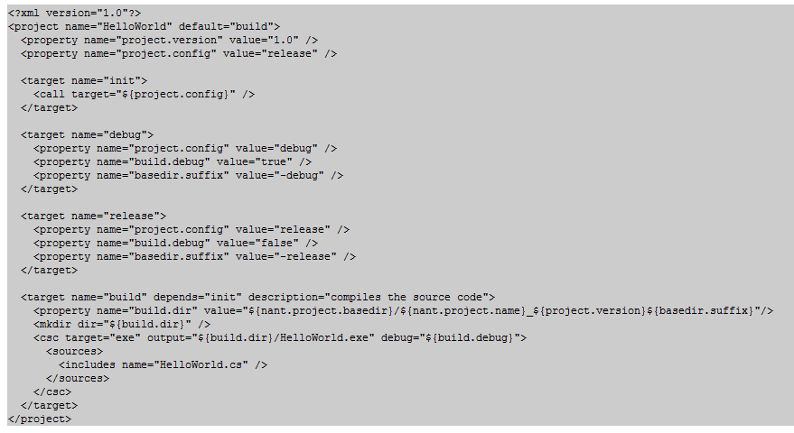
External DSLs
Notes:
Language separate from the main language of the application it works with
Custom syntax, common to borrow other syntax
Parsed in the host code using text parsing techniques
When to use External DSLs?
Good for when non-coders are using the DSL
Not compiled in to the application
More dynamic/flexible in nature

Slide 6
External DSL Processing
DSL script
Semantic Model
Target Code
Parse
Generate

Slide 7
External DSL Processing
DSL script
Semantic Model
Target Code
Parse
Generate

Slide 8
Parsing
Lexer/Parser tool
yacc
ANTLR
Irony
Language Workbench

Slide 9
Parsing
1 + 2

Slide 10
Semantic Model - AST
BinaryNode
NumberNode
NumberNode

Slide 11
Generate
Walk the tree manually
Build a C# expression tree
Compile it
Magic

Slide 12
Irony
Internal DSL in C#
Follows standard parsing formats (EBNF)
Used to build parsers for External DSLs

Slide 13
Demo

Slide 14

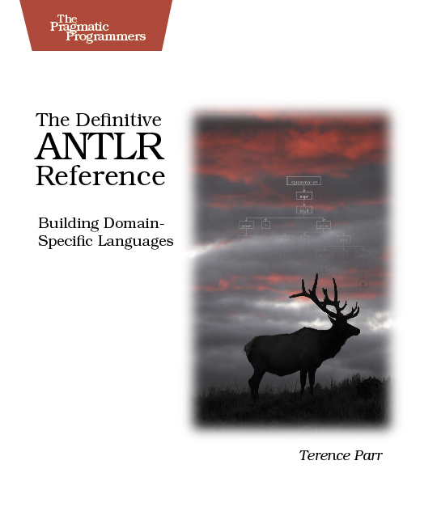
For more info

